Slide 1
KG COLLEGE OF ARTS AND SCIENCE DEPARTMENT OF ELECTRONICS AND COMMUNICATION SYSTEMS
NAME :ARUNKUMAR M
CLASS :III B. Sc ECS
ROLL NO :2026B02
REG NO :2026B0009
GUIDE:
Dr.S.Karthikeyan
ASSISTANT PROFESSOR

Slide 2

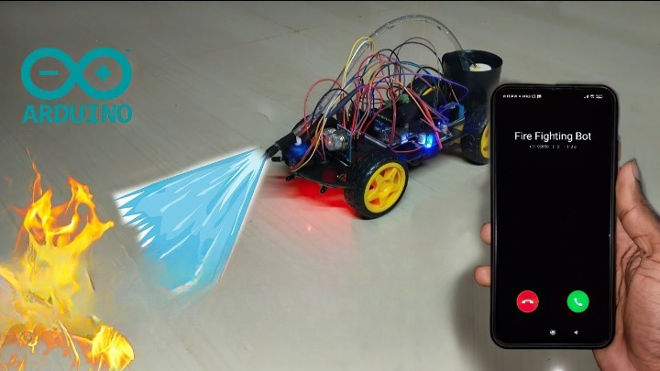


FIRE FIGHTING ROBOT WITH SMS AND CALL ALERT

Slide 3

ABSTRACT
Develop an intelligent multi sensor based security system that contains a Fire Fighting robot in our daily life.
The destructive burnt cause by electrical is the highest source. It is because security system can’t detect abnormal and dangerous situation and notify us.

Slide 4
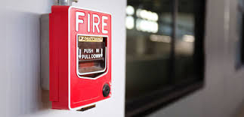
EXISTING SYSTEM
The fire alarm system detects smoke, heat it alerts occupants of the building using both audible and visible alarms.
Alarms will be bright, loud, obnoxious, and impossible to ignore, which help mobilize individuals to follow your evacuation plan.

Slide 5
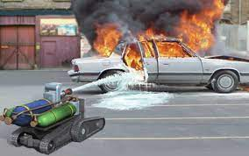
PROPOSED SYSTEM
The intelligent multi sensor based security system that contains a Fire Fighting robot.
It detects fire and smoke and gives SMS and Call before the fire becomes very explosive and Assists firemen in fighting high-risk fires.

Slide 6
INTRODUCTION
One of the most important parameter in life is fire disaster, i.e. lives lost in saving someone else life.
In today’s generation a lot of robots are proposed and designed to remove the human factor from dangerous and deadly work.

Slide 7
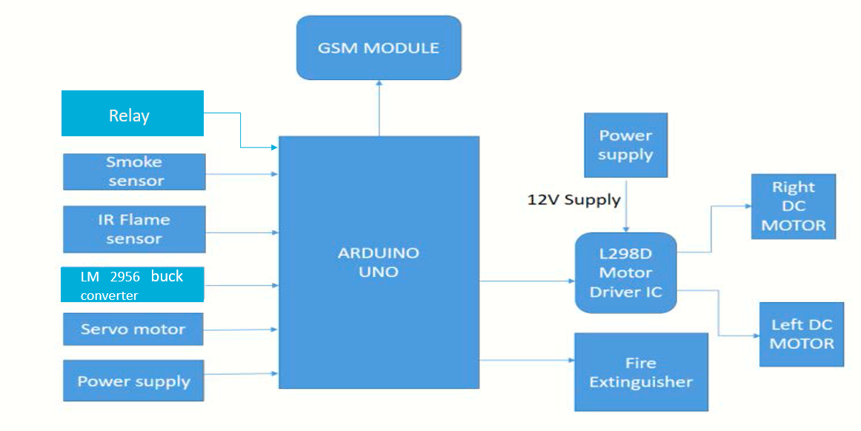
BLOCK DIAGRAM
Buck Converter
IR Flame Sensor

Slide 8

BLOCK DIAGRAM DESCRIPTION
Fire Fighting robot is controlled by the coding on Arduino it gets the input from the flame sensors and smoke sensor on the front of the circuit.
The inputs from the sensors are sent to the Arduino and processed then it controlled the motors by the motor driver L293 and then it driven near the flame and activate the Fire extinguisher.

Slide 9
IMPLEMENTATION Hardware Requirements
Arduino UNO
DC motor with Wheels
Motor Driver L293
IR Flame Sensor
LM 2596 Buck Converter
GSM SIM 800L
Mini Water pump
MQ-2
Connecting wires & Mini bread board
Li-On Battery
Servo Motor
Relay Module

Slide 10

Software Requirements
Arduino IDE
Embedded C

Slide 11
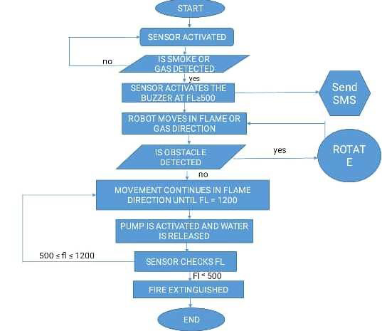
FLOW CHART
Rotate
yes

Slide 12
APPLICATIONS
The Fire fighting Robot is a compact and portable emergency responder robot that assists firemen in fighting high-risk fires, especially in highly dangerous environments where it is not safe for people to enter.
It is used to get alert through SMS and Call before the fire becomes very explosive and extinguish the flame at the starting stage to save the people and the environment.

Slide 13
ADVANTAGES
Fire Fighting robots can fully play their role in various dangerous and complex environments .
Reliable and Economical.
Fire-Fighting robots can be used repeatedly to exert their effectiveness while being carefully maintained.

Slide 14
DISADVANTAGES
Little period of working time and low storage of water provided.
It is not used to put out in large fire.
It can't be used beyond the limit

Slide 15



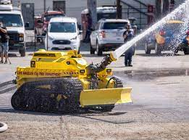
FUTURE SCOPE
By Replace the Flame sensor with Camera and Arduino with Raspberry pi.
Advanced autonomous fire extinguishing system can combat fire accidents and minimize damage to both human lives and property without exposing fire.

Slide 16
CONCLUSION
Developing and implementing an autonomous firefighting system with SMS
and CALL alert feature.
Sensors that can detect fires and send alerts to the relevant authorities.
The development of an extinguishing robot that can be sent to fight fires.

Slide 17
THANK YOU

